Slide 1
Title of the poster
Topic: Topic Nr - title……..
Author: …..author presenting the poster
Company: …
Contact : ….. (email address with link)
Your link …
Introduction
This ppt shows the template that can be used
The content of this ppt is an example.
Point 1: what the poster sessions will look like
Point 3: Interaction with visitors
Point 2: How it works
You can insert a link to a web page or other
Conclusion:
Be innovative!

Slide 2
Introduction / context
5 slides
Landscape format
A size limited to 15 Mb
May content
Web links
Images
Etc.
…..
…..

Slide 3
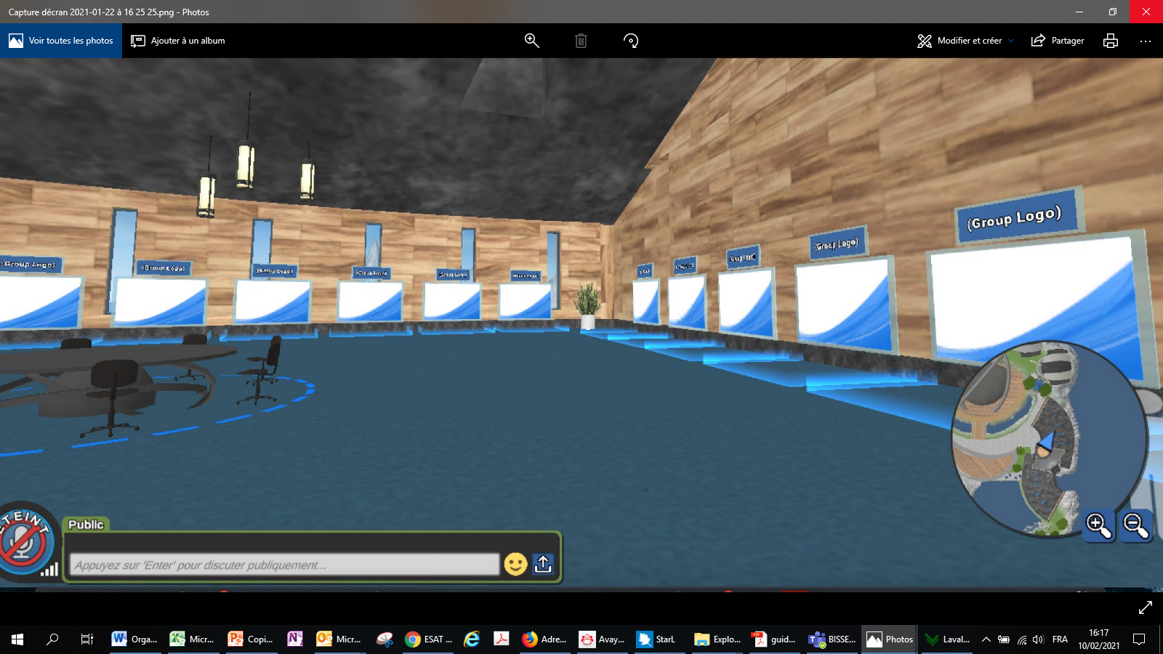
TITLE pOINT 1
Each author will be given a dedicated screen
The identification will be posted
at the entrance of the room
and on the Basin Modeling Workshop website
…..

Slide 4
TITLE POINT 2
The content of the poster will only be visible to avatars inside the blue zone surrounding each position
Your dedicated screen allows you to browse on the web and share your camera if needed

Slide 5
TITLE POINT 3
During the time assigned for the poster session, you are invited to stand next to your poster to answer the questions of the visitors
The content of the poster will only be visible to avatars inside the blue zone surrounding each position

Slide 6
Conclusion
the Green Center is open from Friday 4 June, you can come to consult or download your documents
Laval Virtual technical assistance as well as organisation staff will be available for any questions
The file pdf of your poster must be sent to BMworshop@ifpen.fr at the latest on 1st June identified as follows: nameauthor.pdf (author presenting the poster)
You also have the choice to upload it yourself on your dedicated screen from Friday 4 June.
Be innovative!

